Slide 1
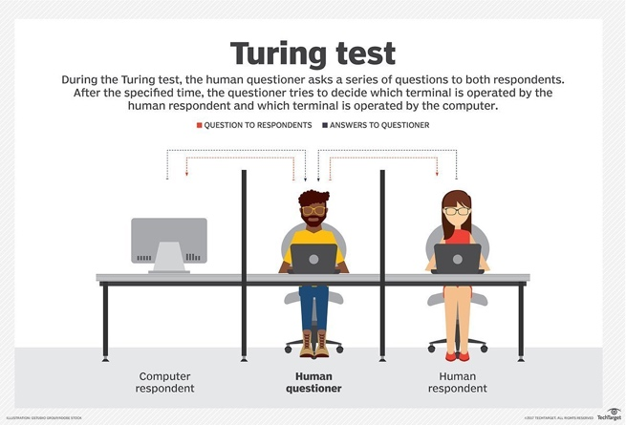

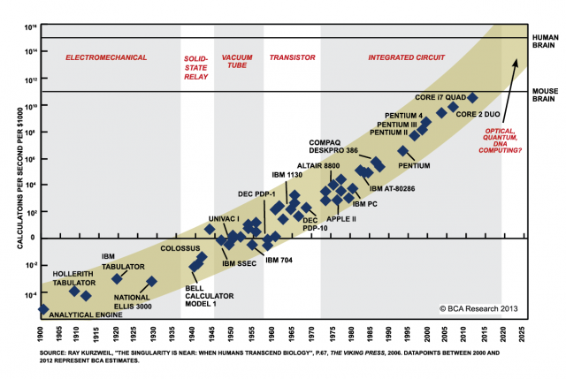
Thread 5 Intro: ICT Awareness & Competency
Ken Lazarus, Ben Koo
May 4, 2021
Moore’s Law
Notes:
https://www.aliexpress.com/item/33004770035.html

Slide 2
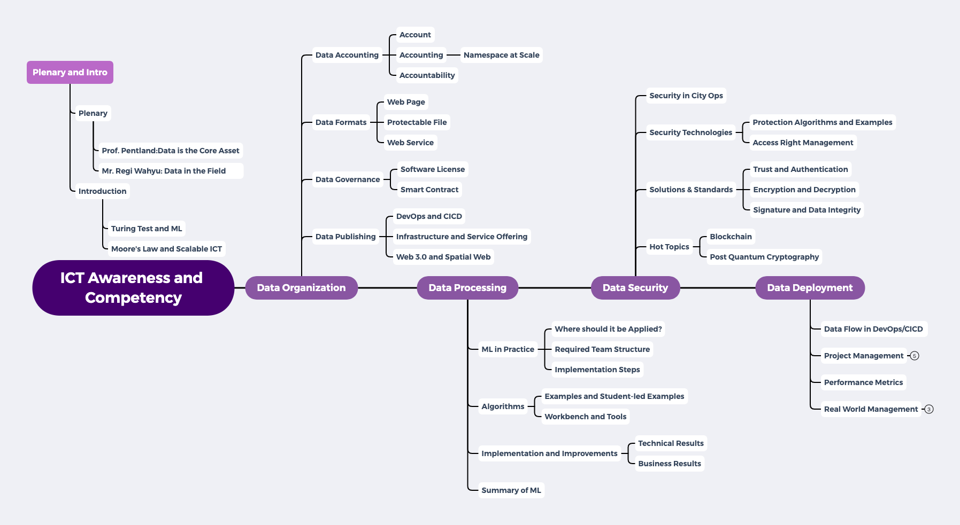
Thread 5 Content Structure

Slide 3
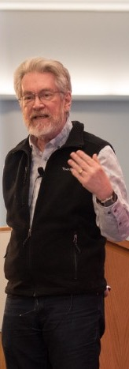
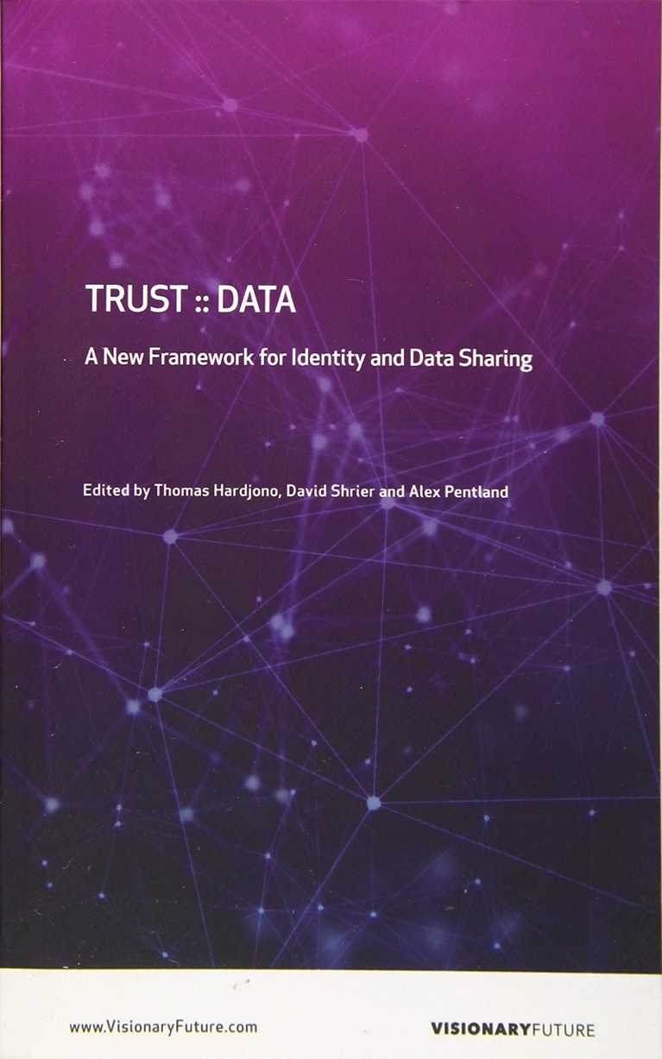
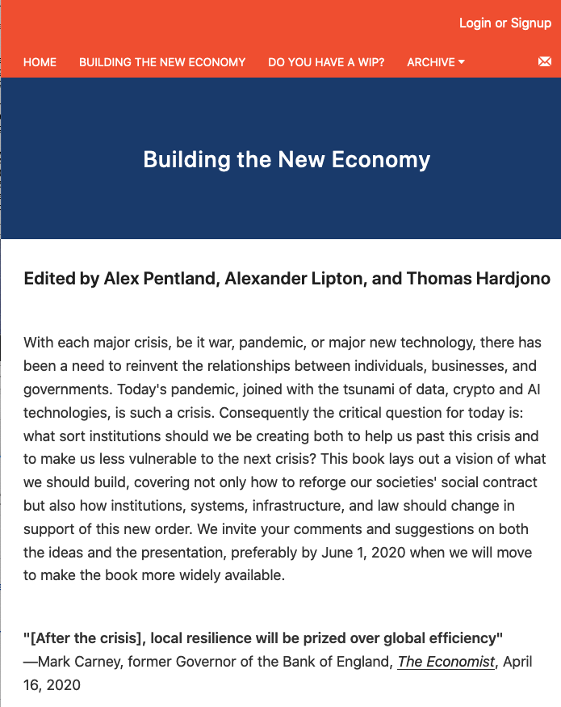
Data is the Core Asset: Code is Law

Slide 4

Data Assets in the Internet Age
Asset Container | Operations | Tools
Page | Content Editing | Semantic MediaWiki
File/Directory | Changing File Structures | Git
Micro Service | Execute Programs | Docker

Slide 5
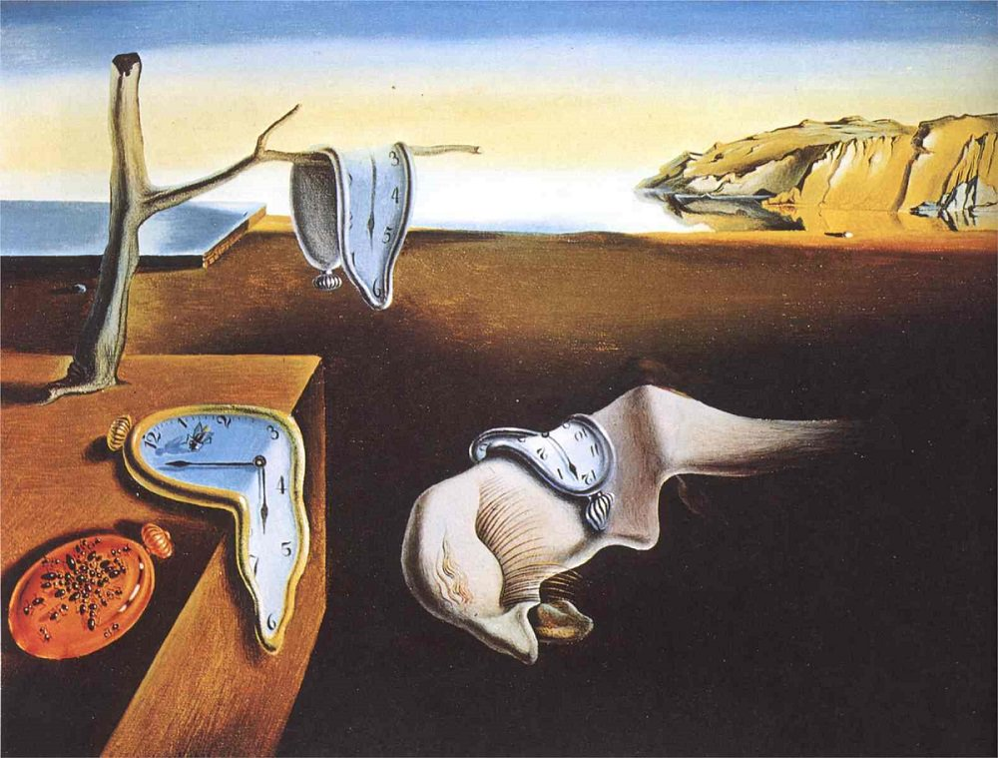
The CONTEXT of Modern ICT practices
GLOBALIZATION AND INDUSTRIALIZATION CHALLENGED THE BOUNDARY OF HUMAN COGNITIVE POWERS
THE SPEED OF CHANGES EXCEEDS MENTAL CAPACITY
Societal Implosion & Globalized Chaos
Incoherent minds and body
overwhelmed by new knowledge
lost of self-worth

Slide 6
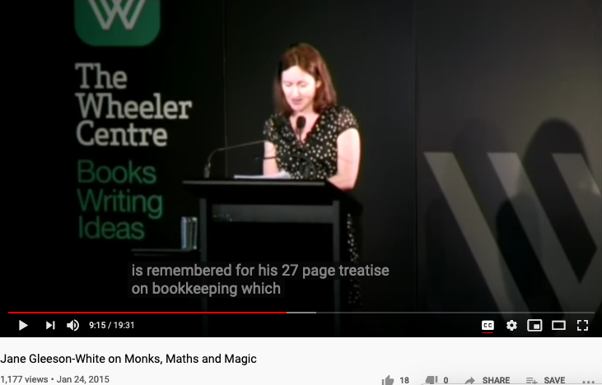
How Accounts/Data Scientists can Save the World…
Inspired by a conversaion with Enki at
Kura Kura Bali Campus in 2019
Video Link: https://youtu.be/jmVfDbqRxKo

Slide 7
Making Data Accountable is the Simplest way to save the world!

Slide 8
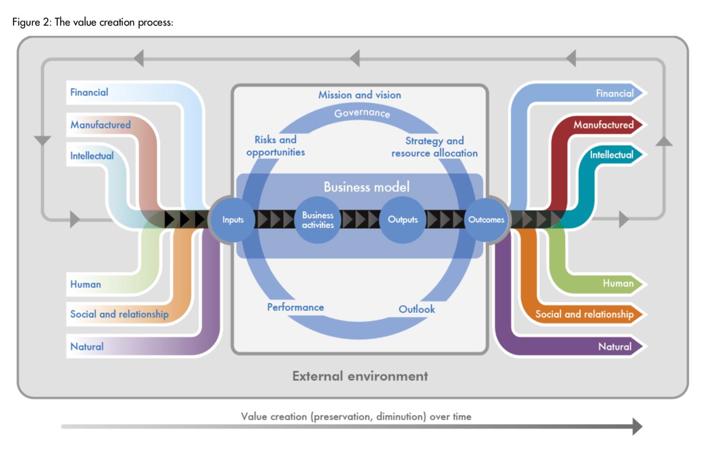


The Ouroboros Structure makes Data Accountable
The International
Integrated Reporting
Framework
Dec. 2013
Notes:
“historian James Aho linked double-entry bookkeeping to the ancient art of rhetoric,”
Excerpt From: Jane Gleeson-White. “Double Entry.” Apple Books.

Slide 9


Abstract Specification
Logic Model
Logic Model
Concrete Implementation
Context: Inadequate ICT Awareness causes Digital divide.
Goal: Enhance awareness of essential ICT tools
Criteria:
Understand ICT terminologies
Observable utilization of Hyperlinked digital content
Output: A continuously evolving Data Workflow
Process: Relate data assets using Hyperlinks
Input:
Happy Participants
PKC/MediaWiki Infrastructure
A well-defined set of Actions and iterative Branching Strategies
A Roadmap of composable activities
Sequencing and timing conditions
Explicitly state dependencies and resource requirements
Boundary Conditions: Lack of access to networked Modern Browse

Slide 10
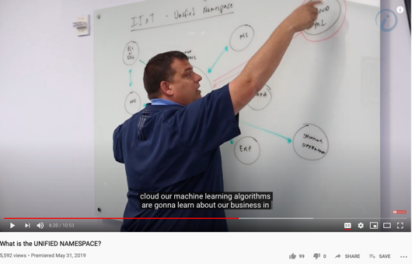
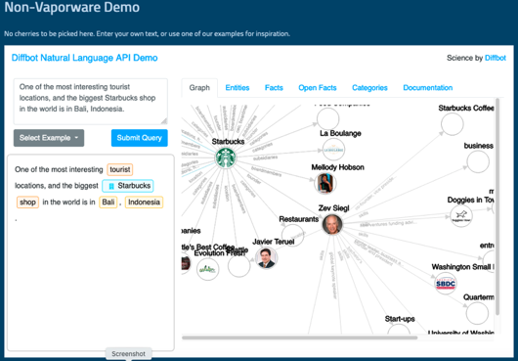
The Digital way to Govern Activities in Space-Time
Transform everything into Data
(labeling things at a Global Scale)
ICT Term:
Namespace Management
Image credits: http://verses.io

Slide 11
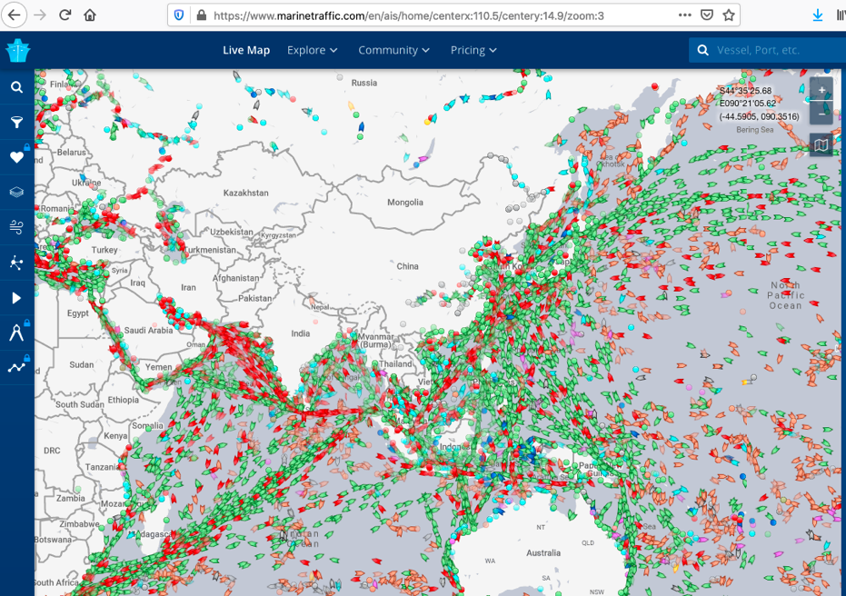
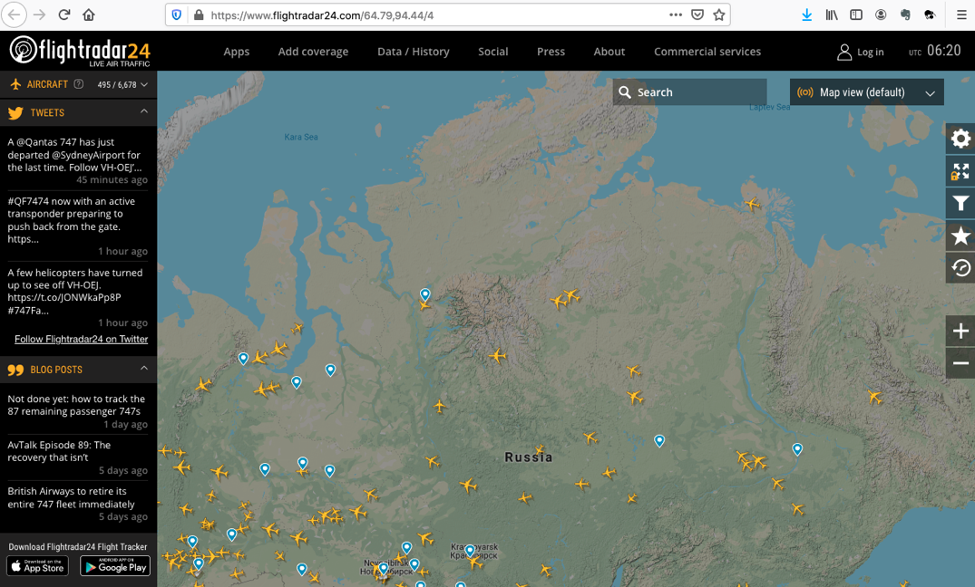
Public access to Spatial/Temporal Data Now!
Modern Web Browsers are devices for intuitive “Namespace Management”
https://www.flightradar24.com/
https://www.marinetraffic.com/

Slide 12
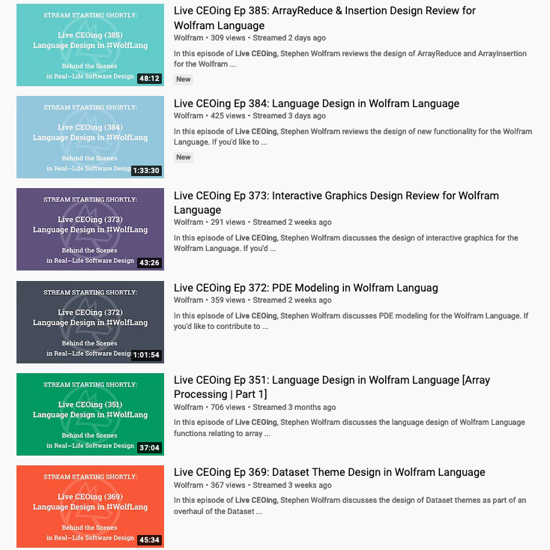
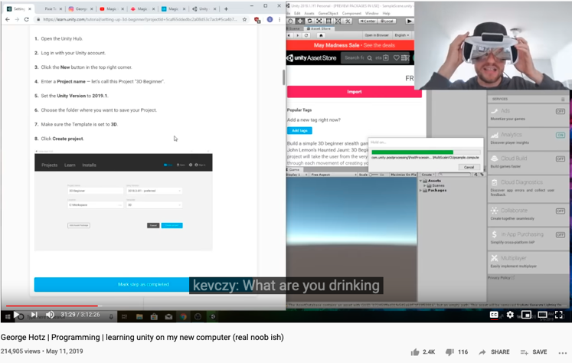
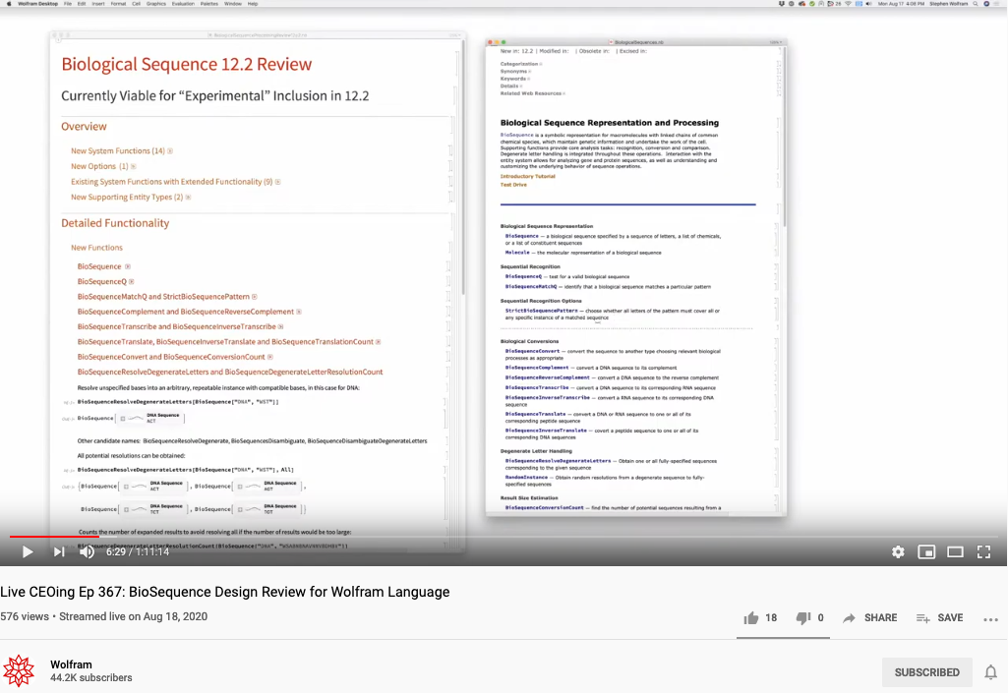
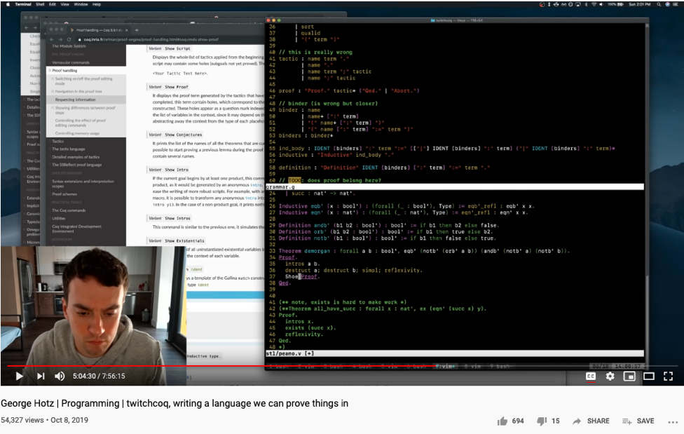
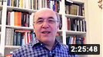
The World has changed … Ways to conduct business have changed …
https://en.wikipedia.org/wiki/George_Hotz

Slide 13
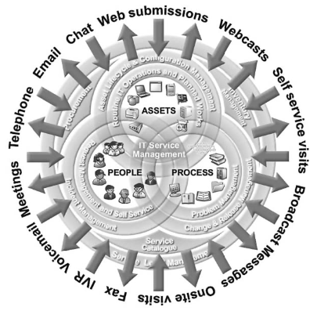
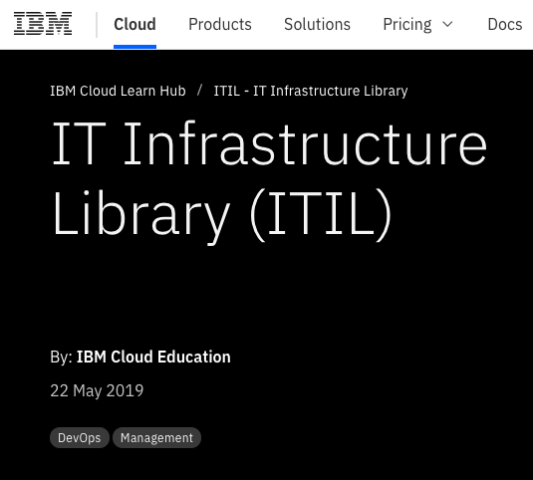
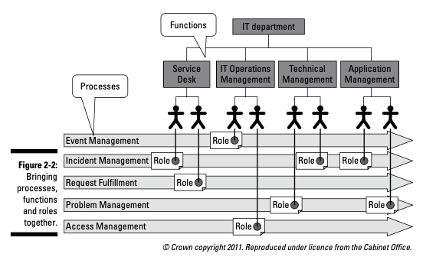
The fast changing pace forced the ICT to come up with ITIL
ITIL: Information Technology Infrastructure Library (Dictionary of ICT Tools)
Namespace management for ICT Operations.
p.33 of ITIL for Dummies
By Peter Fareden
IBM’s ITIL Web Site
p.97 of Effective IT Service Management to ITIL and Beyond
By Rob Addy

Slide 14
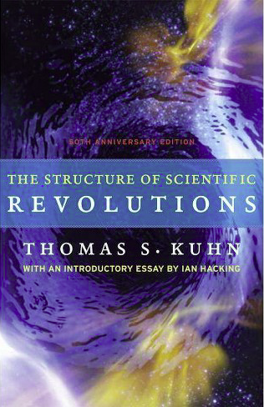
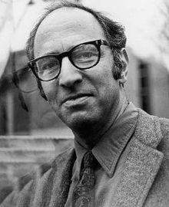
Kuhn Cycle coin-phrased innovation as “Paradigm Change”
A pardigm is a situation that cannot be represented by earlier vocabulary. Therefore, people’s “dictionary” must be
updated accordingly.
Emerging cases or
systematic attacks?
Normal Science
Model
Drift
Model Crisis
Model Revolution
Paradigm
Change
Ouroboros Snake
in five named stages
Thmoas Kuhn in 1973
Image source: wikipedia

Slide 15
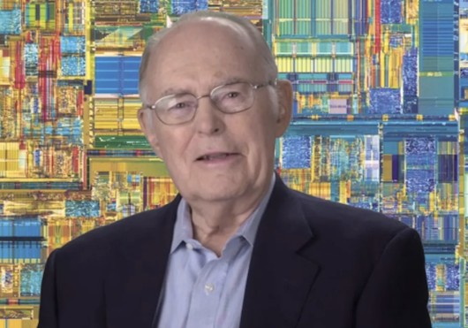
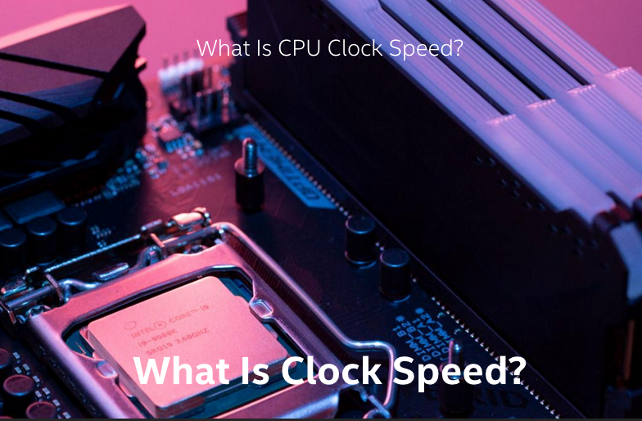

Societal Clockspeeds prescribes Windows of Opportunities
Gordon Moore, Intel Founder
Density of transitor count doubles every 18 months…

Slide 16
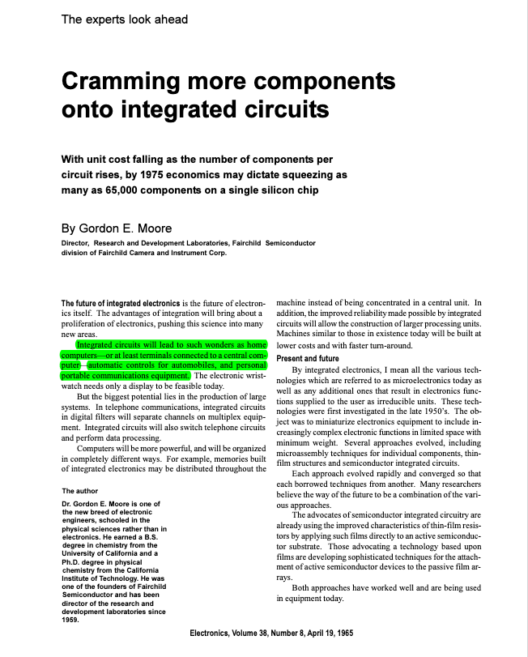
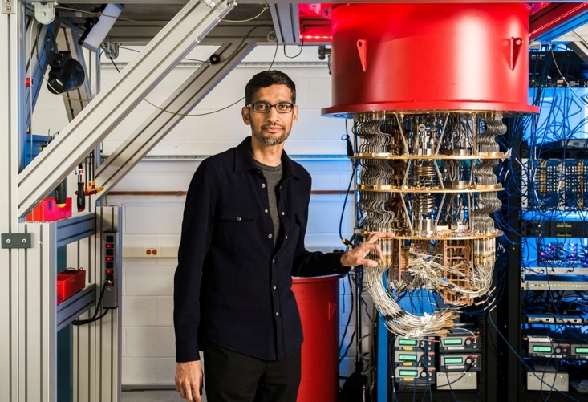
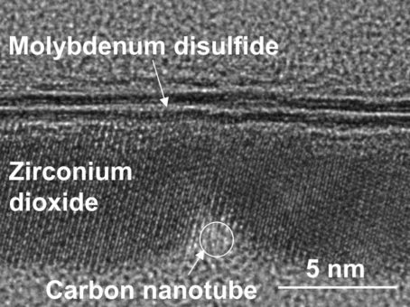
Moore’s identified a measurement to anticipate the Physical dimensions of Data
What is Quantum Physics?
The currently minimal physical phenomena that can reach consensus.
Created a consensus mechanism on the
physical worth of Data changed our lives.
Google lays claim to 'quantum supremacy’
- Bangkok Post
The smallest Transitor, ever!
- Berkeley Lab
Notes:
https://www.etsy.com/sg-en/listing/959281905/wall-clock-salvador-dali-the-persistence?ga_order=most_relevant&ga_search_type=all&ga_view_type=gallery&ga_search_query=dali+clock&ref=sr_gallery-1-10&from_market_listing_grid_organic=1

Slide 17
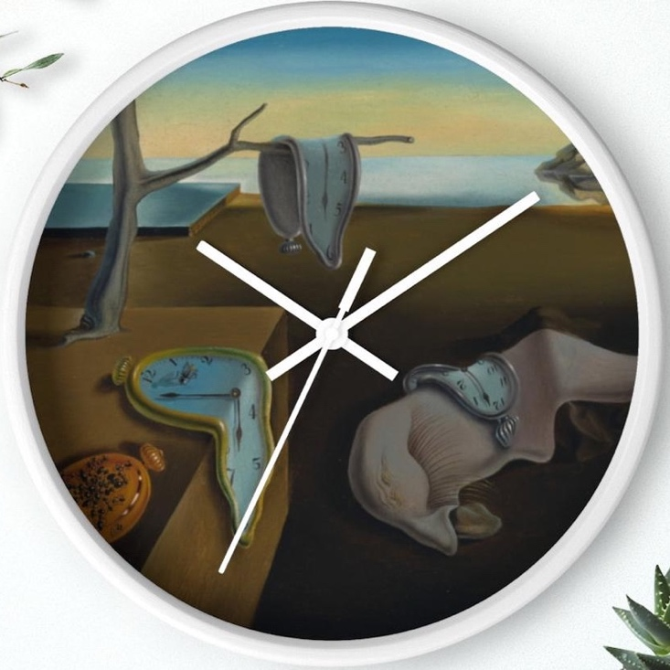
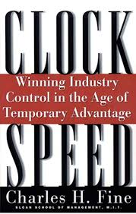
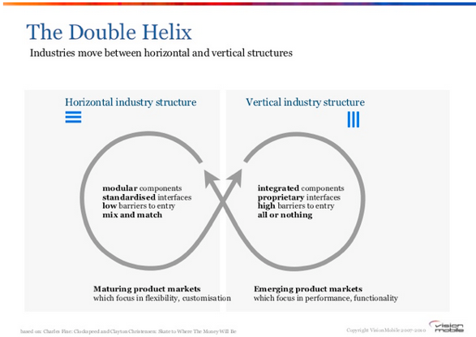
Data Awareness Learning Outcome: (Namespace Management) Managing a fast-evolving Vocabulary
Emerging cases or
systematic attacks
A world under observable acceleration in terms of Industry Clock Speed.
Normal Science
Model
Drift
Model Crisis
Model Revolution
Paradigm
Change
Moore’s Law prescribed the
anticipated clock speed
of paradigm shifts
For the last 50+ years…
See image source by clicking here
Image Source: Mobile Megatrends 2010
Notes:
https://www.etsy.com/sg-en/listing/959281905/wall-clock-salvador-dali-the-persistence?ga_order=most_relevant&ga_search_type=all&ga_view_type=gallery&ga_search_query=dali+clock&ref=sr_gallery-1-10&from_market_listing_grid_organic=1

Slide 18
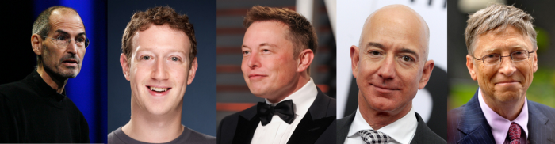
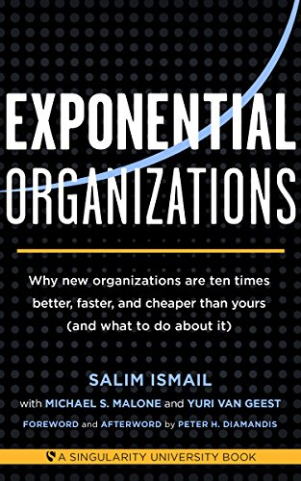

Moore’s Law is the Awareness of Exponential Opportunities
Moore’s Law equipped visionary enterpreneurs to
systematically attack traditional industries…
What Musk, Jobs , Zuckerberg, Gates , Bezos And Other Top Billionaires Have In Common That Everyone Do Not Know.
by Vivek Sakpal May 19, 2018
Normal Science
Model
Drift
Model Crisis
Model Revolution
Paradigm
Change

Slide 19
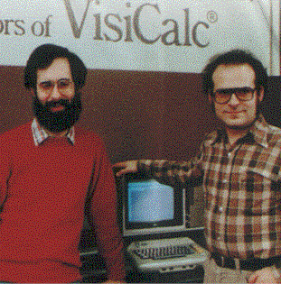
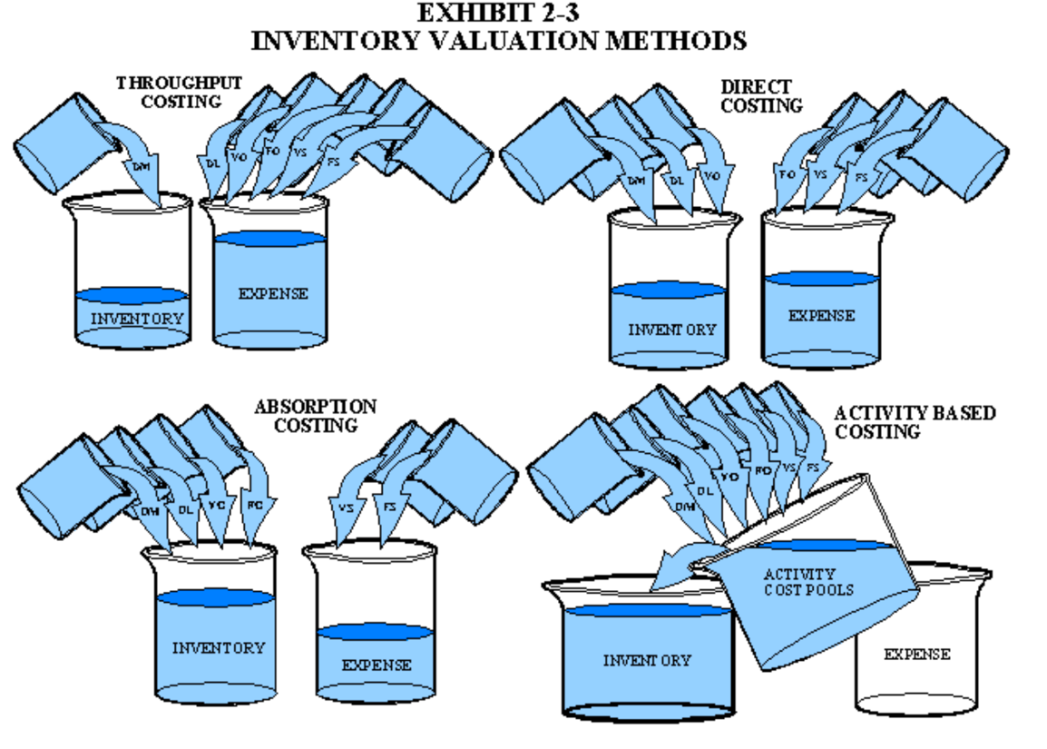
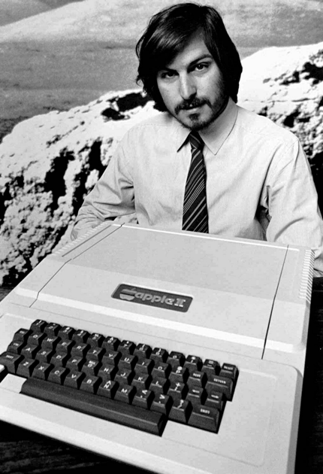
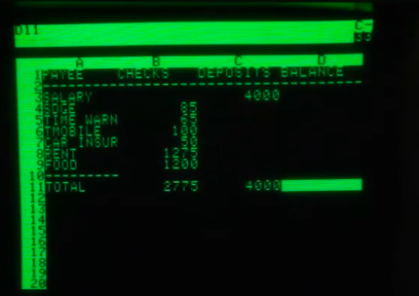
In 1980s, due to the invention of SpreadSheet on Personal Computers, the notion of Activity-based Cost Accounting, namely ABC Accounting method was born
Moore’s Law distored our spacetime, and most importantly,
it distorted the cycle times of asset accounting
A brief history of Spreadsheet
Software Arts Corporation
Formed on January 2, 1979
Image source: https://maaw.info/Chapter2.htm
http://www.dssresources.com/history/sshistory.html

Slide 20
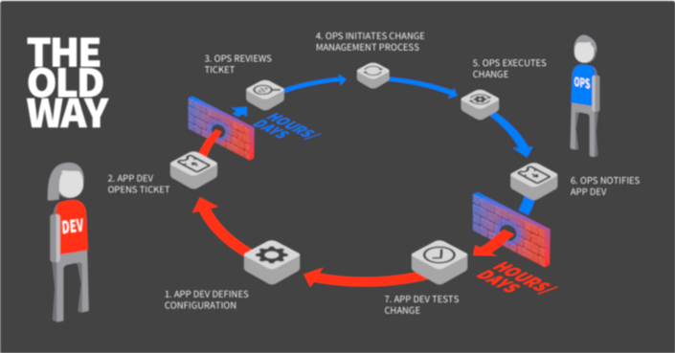

Kuhn Cycles do not specify a “constant” clock speed.
Normal Operations
Drifting Norms
Operational Crisis
User Revolution
Version Upgrade
Without an explicit synchronization mechanism,
the accounting books
cannot reach consensus.
DevOps, Git, and ITIL(dictionary of ICT methods) are efforts to help organizations reach consensus faster.
?
?

Slide 21
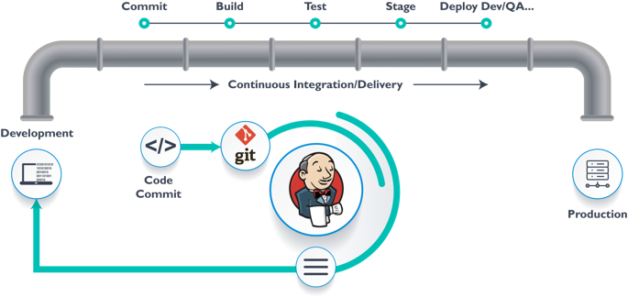
DevOps, Data Ops, AI/ML Ops, GitOps

Slide 22
DevOps, CI/CD reflects to continuous pursuit of ever faster Clock Speeds!
DevOps, Continuous Integration/Continuous Delivery

Slide 23
One Cycle: Git as the Single Source of Truth
Normal Science
Model
Drift
Model Crisis
Model Revolution
Paradigm
Change

Slide 24
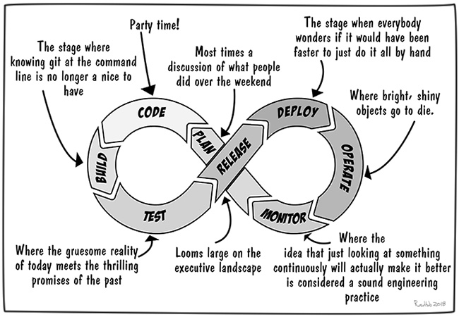
Two Cycles present a story of DevOps
Image Source: https://devops.com/devops-ouroboros/

Slide 25





Three Cycles cover micro/meso/macro Time Scales
(students/teachers)
(Smart) Social Contract Execution
Traders
Miners
Coders
Fast Responding Web Pages
Three Asynchronous
Clocks in their respective
Communities
Micro-time Scale
(Consumers/Distributors)
Creative Content in Protectable Files
Macro-time Scale
Trust-worthy Web Services
Version Upgrade
Production Code
Function Requests
Customer Crisis
Feature Revolution
Meso-time Scale
(Artists/Creative Projects)
(Administrators/Witnesses)
Perform Checking
receive confirmation
commit transaction
(Content Producers/Product Designers)
(Accountants/Lawyers)

Slide 26
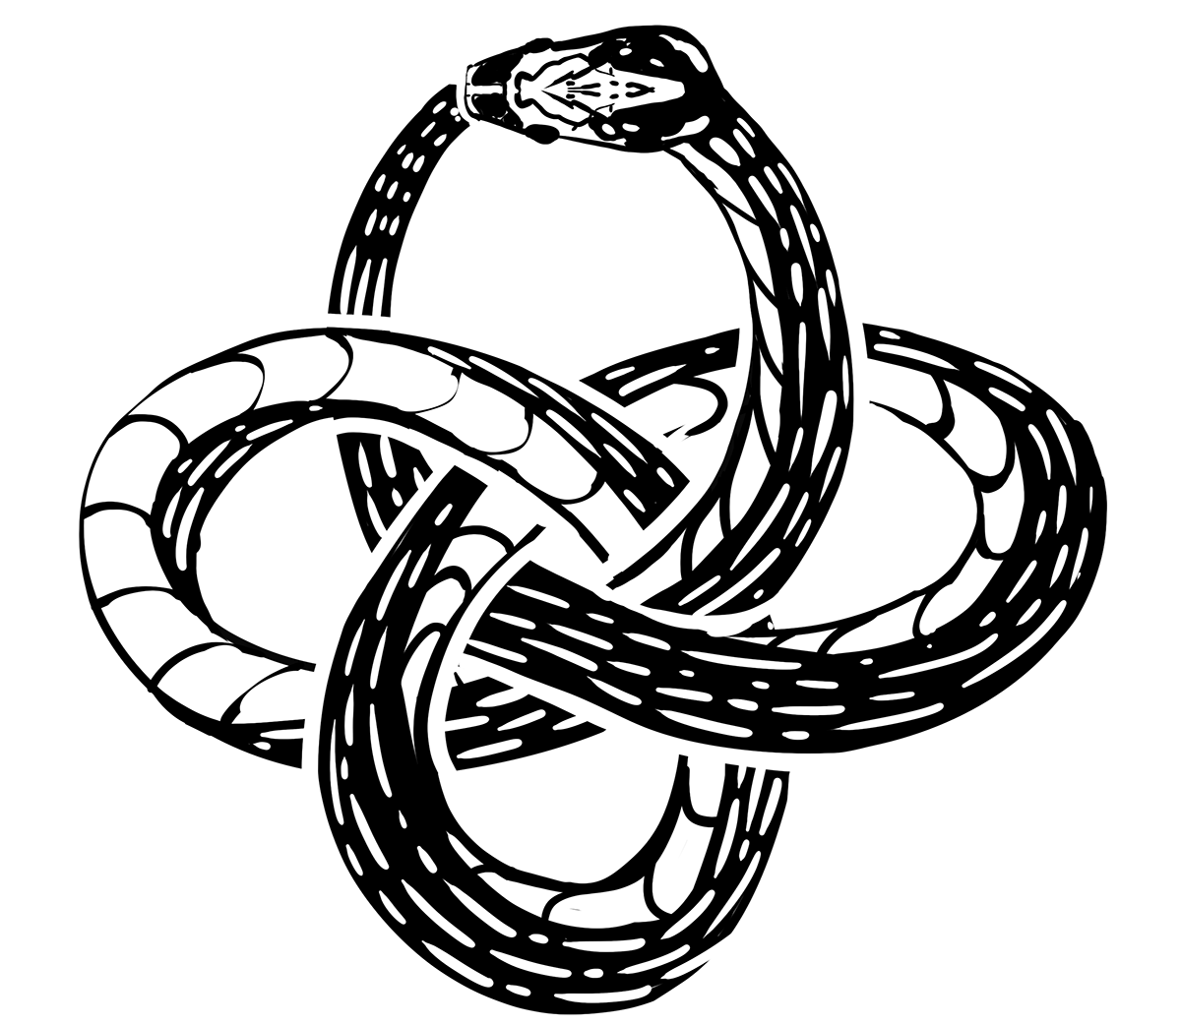

Blockchain is the “Constant” clockspeed Technology: Time (Consistency) is Money
Chained Data only becomes valuable when
they are “entangled”.
Blochain is a consensus technology.
https://www.investopedia.com/terms/b/blockchain.asp

Slide 27

Data Accounting Practice
Accounting alone is insufficient
Value Creation Workflow
Data Processing:
Calculation and Optimization
Data Security:
Asset Protection through secret keys
Data Deployment:
Faster response time, lower unit costs
Data Processing:
Cheap enough computing efforts
Data Security:
User interface must be so easy that …
Data Deployment:
DevOps, CICD, Dictionaries of ICT tools
A well-defined set of Actions and iterative Branching Strategies
A Roadmap of composable activities
Sequencing and timing conditions
Explicitly state dependencies and resource requirements

Slide 28
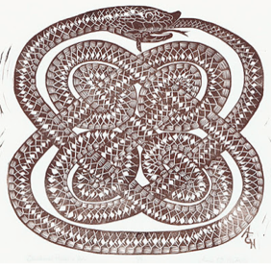

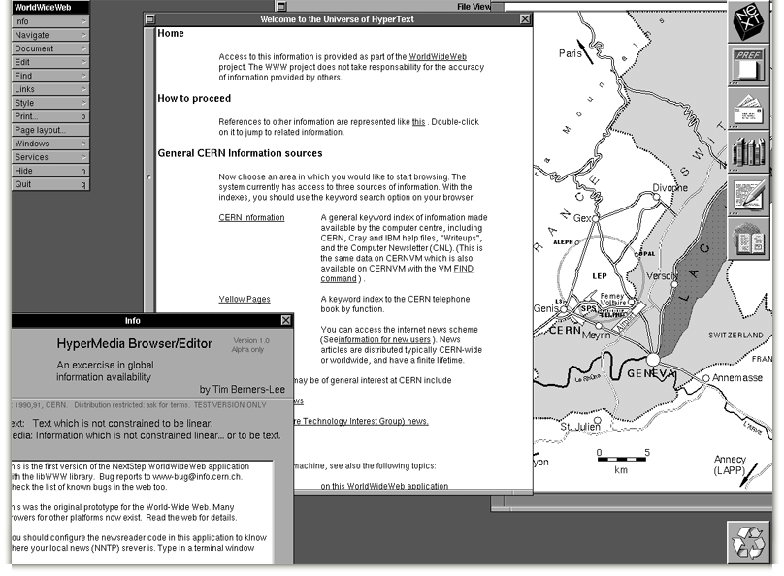
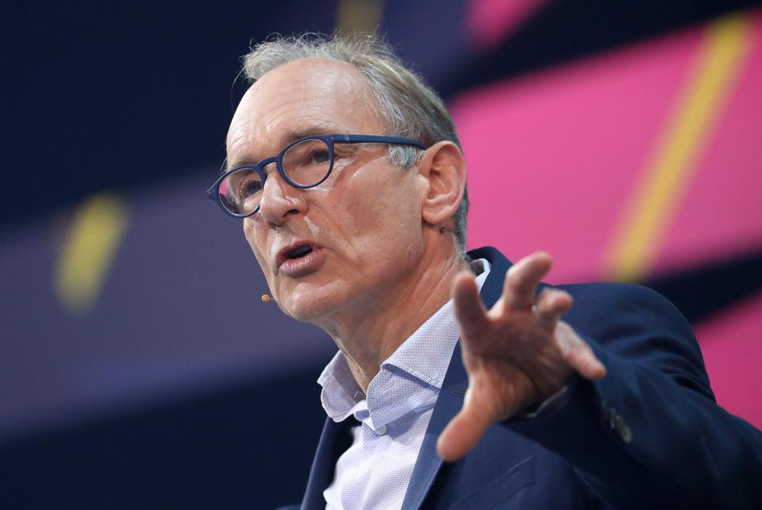

Enter the Age of the Web
The Semantic Web
Berners-Lee called his vision for the web “utopian.”
He wanted it to be a place where all people had access to the best information at any time.

Slide 29

Instrumentation of DevOps
Image courtesy: PETSEBAN on NearCoding

Slide 30
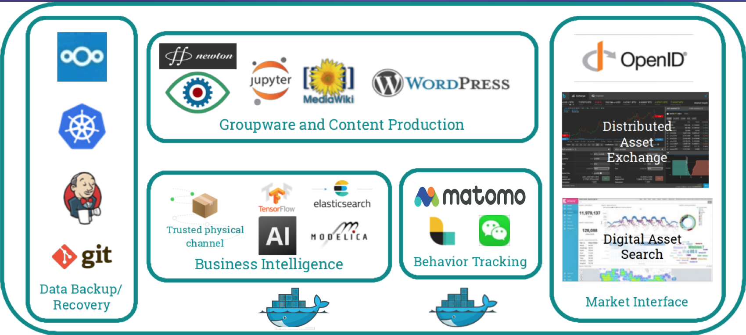
Digital Tools in Software Containers

Slide 31
Contract being a kind of Accountable Data!

Slide 32
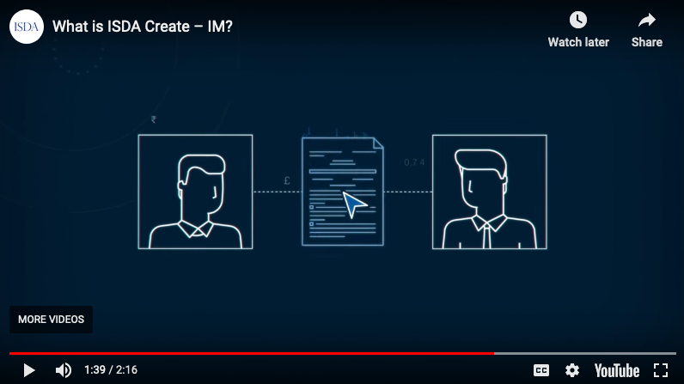
Smart Contract with Observable Historical Data
A contract is a piece of data that documents consensus.
ISDA: International Swaps and Derivatives Association

Slide 33
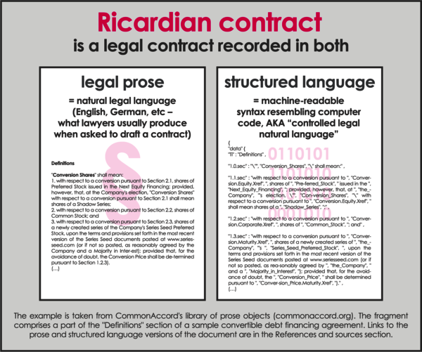
Digital Contract Socially bound Digital Twin
Smart/Digital Contract is a
Consensus Enforcement Technology through Accountable Data.

Slide 34
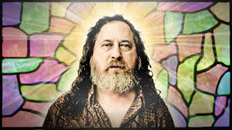
Not Information Asymmetry, but promote the Principle of Information Symmetry

Slide 35
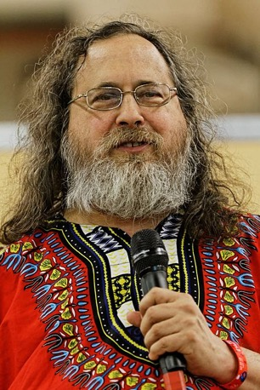
The Mother Contract: Open and Free
Open Source
Right to use publicly available technologies and other resources in the learning process
Right to resolve conflicts in a dynamic context in digitized space
Freedom to make decisions related to one’s personal digital assets
Freedom to express one’s opinions
Free Software
(See the recursive structure?)
Founder of Free Software Foundation, and Creator of GNU/Linux. Image credit: Wikipedia
Paraphrased from “Free Software, Free Society” by Richard Stallman

Slide 36
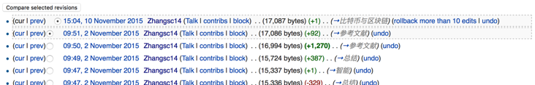

Three Scales of Time
Mesoscopic：
Localized Adjustments
Time Stamp
Macroscopic:
Five Stages of Evolution
Normal Science
(commit)
Model
Drift
(build)
Model Crisis
(test)
Model Revolution
(stage)
Paradigm Change
(deploy)
Microscopic：
Process Data and Summative Result
Time Stamp

Slide 37
Universal Data Abstraction is necessary because technologies are simply not Simple Enough!

Slide 38



Jeff Bezos and his No Power Point Policy

Slide 39



Bezos’s NPPP eventually created DevOps

Slide 40

Amazon Lambda offers Function as a Service (FaaS)
Amazon’s unifying approach to Commoditize Web Data and Computing Services.
The following diagram is a universal specification of all computable procedures called lambda calculus.
Variable
Expression1
Expression2
𝜆
Variable
Expression
( )
Expression
Lambda calculus as an executable rewrite process is a Lattice/Poset. It is also a formal definitino of Ouroboros.
A “lambda” function is a piece of data that can define more functions.

Slide 41

Learning Process as a Publishing Workflow
Traders
（students/teachers）
Miners
（Administrators/Witnesses）
Coders
(Artists/Creative People)
(Consumers/Distributors)
(Content Producers/Product Designers)
(Accountants/Lawyers)

Slide 42


Data Exchanges at many time scales
Traders/Hunters
（students/teachers）
Miners/Herders
（Administrators/Witnesses）
Coders/DNA Editors
(Artists/Creative People)
Micro Time Scale
Page Data Flow
Macro Time Scale
Product Development Workflow
Meso Time Scale
Software/Infrastructure Workflow

Slide 43




Holacracy: a mechanism for Communication and Control
Variable
Expression1
Expression2
𝜆
Variable
Expression
( )
Expression
Holacracy applied Recursively
Image Source: Holacracy: The New Management System for a Rapidly Changing World

Slide 44


The CAP Theorem in Data Assets
RICH 70 Tsinghua SEA Cloud Forum, Sep 14, 2020
H. E. Bambang Brodjonegoro,
Minister of Research & Technology, Indonesia

Slide 45


Cybernetics at a Scale of Internet Economy (ITIL)

Slide 46

Learning Resource created by leading Enterprises

Slide 47




Using AI and DevOps to create simulated Cities
(Video: https://youtu.be/hjpHsXRp790)

Slide 48

Operationalizing the Cybernetics
How to deploy a Kubernetes Cluster from Scratch (Youtube Link)

Slide 49
Abstraction
Concretization
Serve as the Control Plane
Define Policies according to high level objectives
Security roles protected by tech not by political influence only
Law enforcement by controlling targeted resources in the Data Plane
Serve as the Data Plane
Resources governed by Configurable Policies
Security-sensitive infrastructure that assigns traceable responsibilities to persons
Provide feedback from real worlds to reflect on the efficacies of laws
A well-defined set of Actions and iterative Branching Strategies
A Roadmap of composable activities
Sequencing and timing conditions
Explicitly state dependencies and resource requirements
Namespace (Data Asset) Management

Slide 50
The Web (hyperlinked) Data is the simplest possible Data to satisfy your needs!

Slide 51

ICT is the business of managing a Living Dictionary
You all have access to a living Dictionary…
The Internet of Things (IoT) is about
labeling everthing with consistent names, therefore, ICT is all about creating a scalable data dictionary or conduct namespace management.

Slide 52
Summary of Intro to ICT Awareness & Competency
Turing Test: A clever argument that classified what kind of data can be “competently” judged by a rigorous procedure and reach meaningful results.
Moore’s Law: Exponentially broaden the awareness of entrepreneurs who saw how data can be processed at an “industry-wide” clock speed, therefore, changed the scope and range of data to be used at scale.
Namespace Management: ICT is about accounting for Data Assets at Scale using big Dictionaries called Databases/File Systems/Web Services
DevOps/CICD are about accelerating clock speeds at multiple levels of workflows.
ITIL (Information Technology Infrastructure Library) is the dictionary for ICT practice and technology awareness.
Universal Resource Locator (URL or Hyperlink), is the forever frontier in Data Asset Management.
MediaWiki is an industry-wide multi-media data dictionary for all applications.
CI/CD: Continuous Integration and Continuous Deliver/Deployment)

Slide 53

Ben Koo
Coordinator for Thread 5: ICT Awareness and Competency
Instructor for Module 5A:
Data Organization
Module 5D:
Data Deployment
benkoo@tsinghua.edu.cn

